Slide 1

Bit:Bot Race Car Project
Line Follower
Lesson 15–17

Slide 2
Objectives
Be able to apply what you have learnt to make the car complete one lap autonomously
Complete one safe lap as quickly as possible
Utilise sensors to automate the car and make the vehicle more ‘intelligent’
Notes:
Remind Learners of the aims of the project

Slide 3
Line Sensor
In Lesson 4 we looked at how the line sensor can be used to detect a black line
You experimented in Lesson 4 with thickness and colour of the line to get the best signal
The Bit:Bot official extension has a built in line follower so you can get your car to follow the racing line around the track
The extension sensor is digital and will read a 1 with no detection and a 0 for line detected
The best way to get a good line is to print a track on a laser printer
Notes:
Discuss the line sensor and its use from Lesson 4
Discuss what Learners discovered relating to thickness and line colour and the reliability of the sensor
Show the Learners the template and how they can use this to construct a practice track and overlays for the racetrack

Slide 4
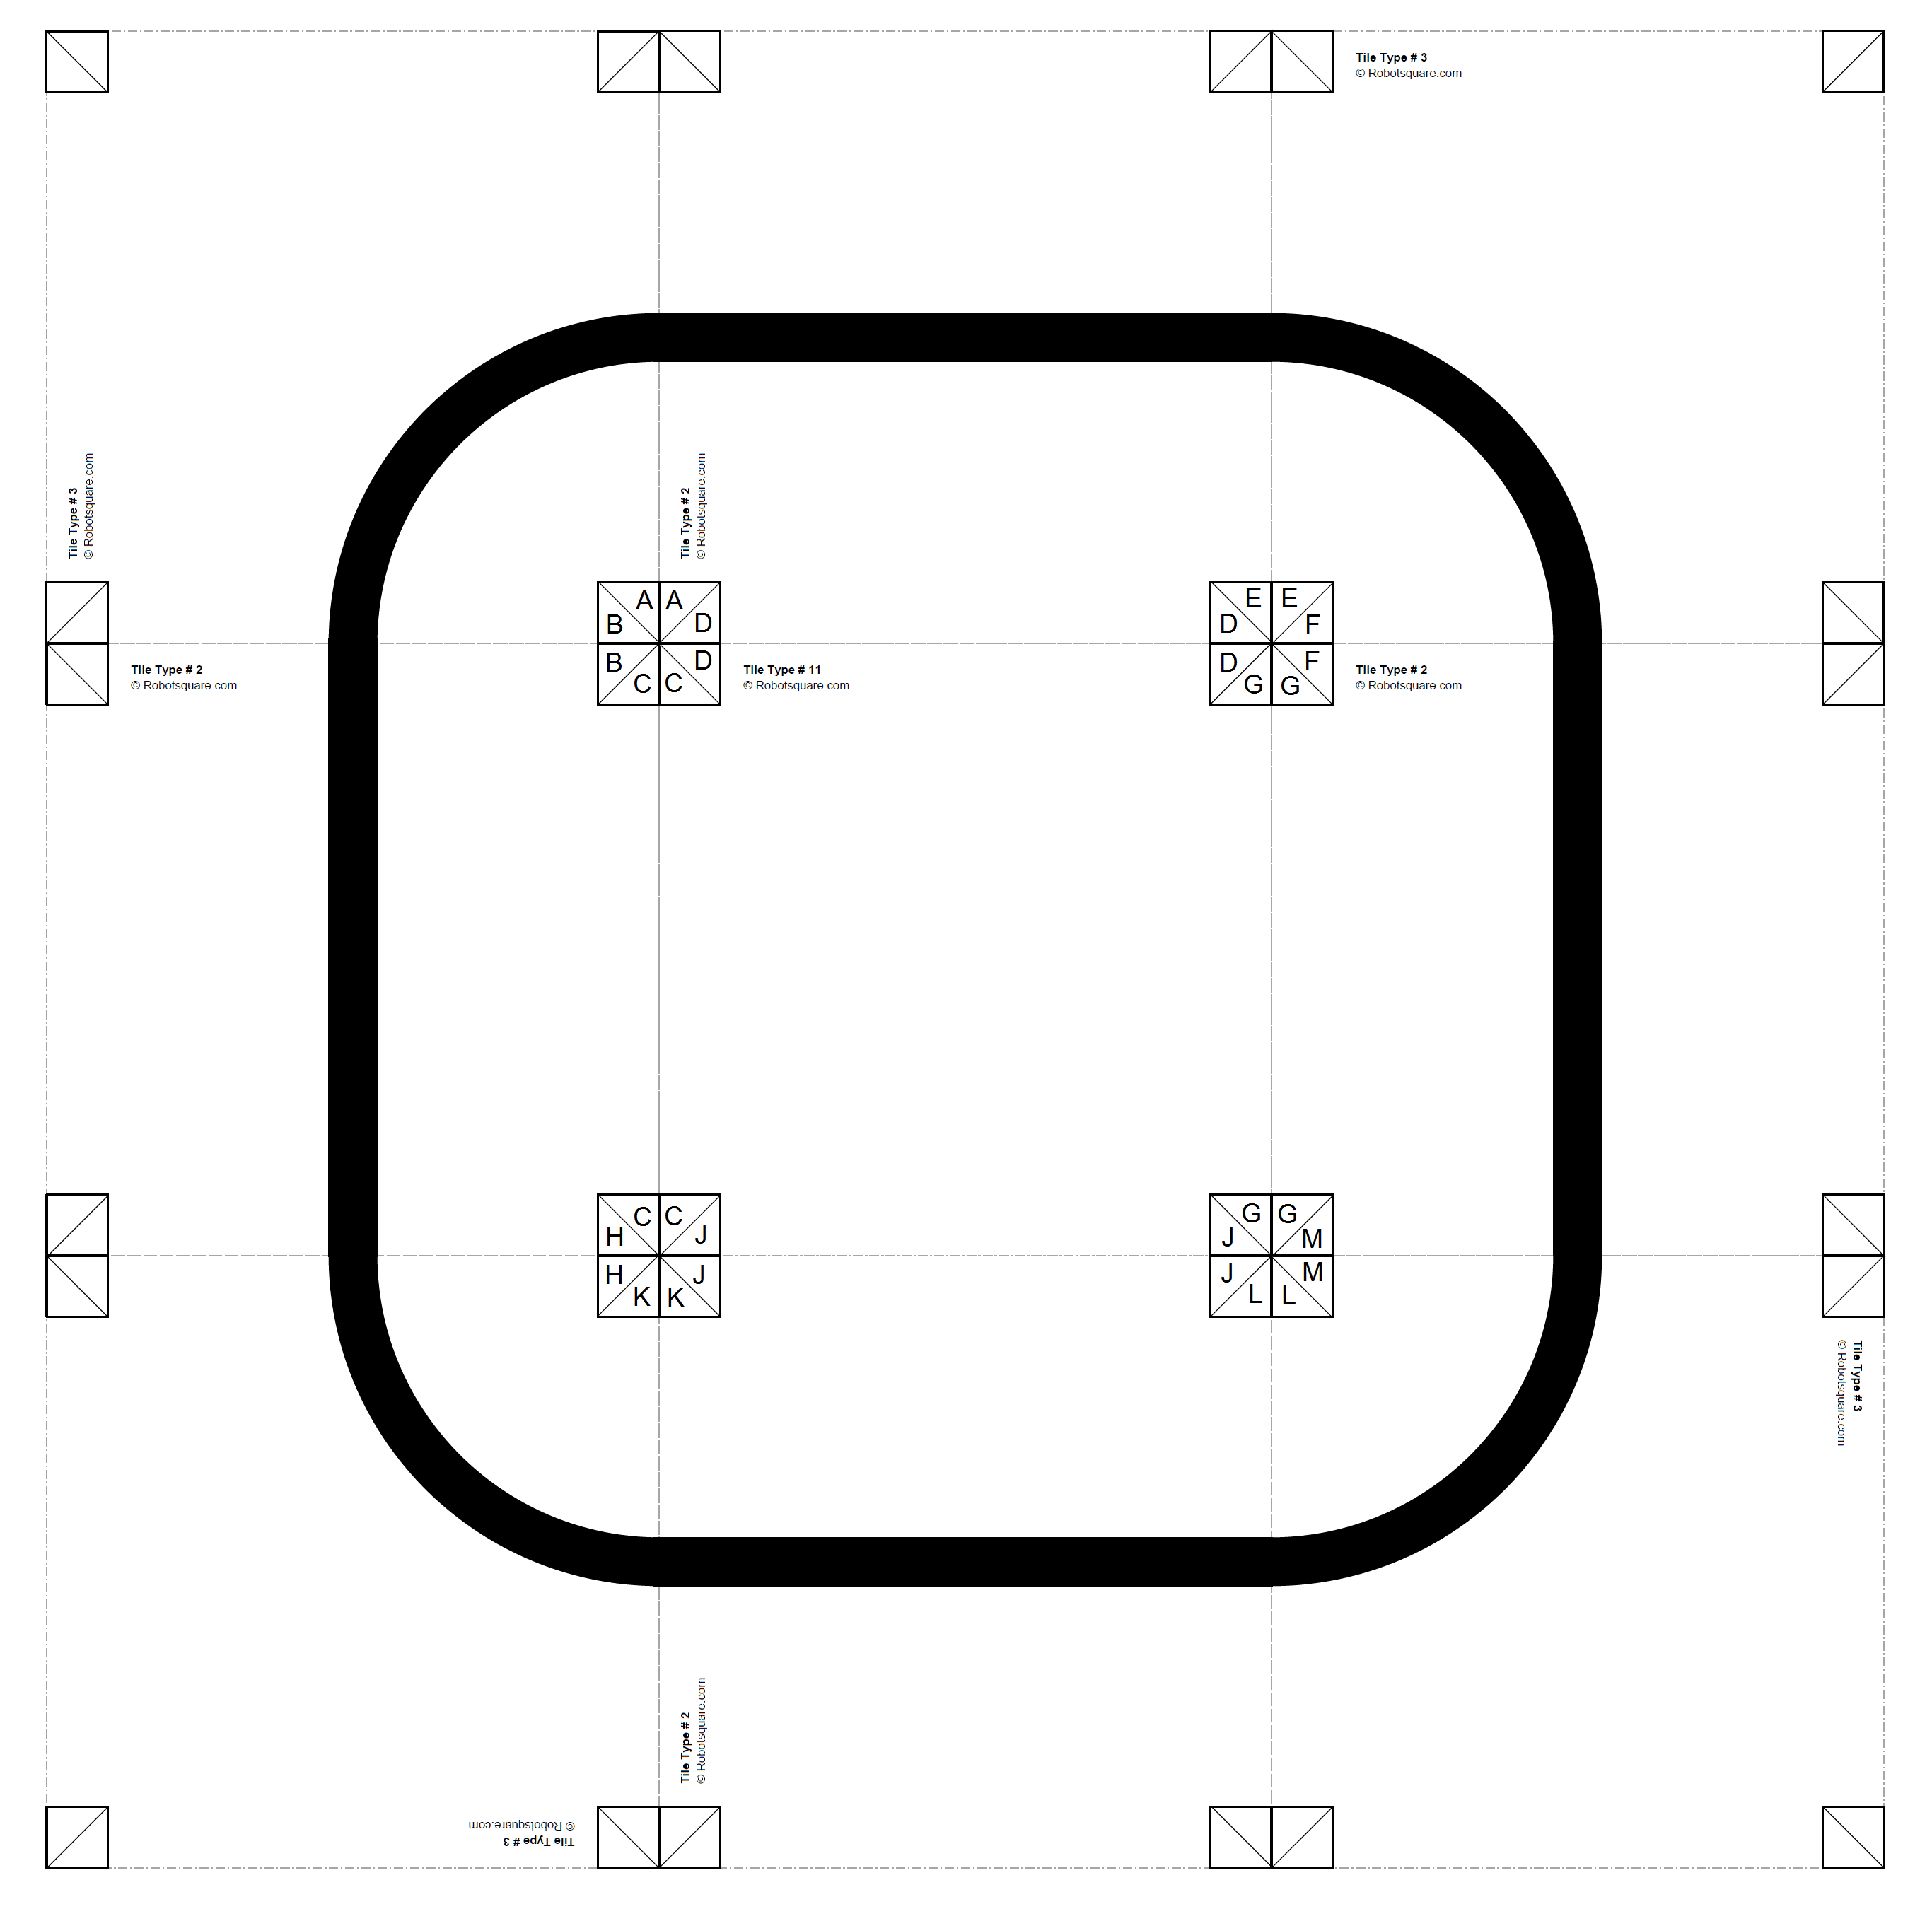
Practice Task
Use the templates or create your own test track
Notes:
Learners build a simple test track using the template.
Learners get their car to follow the racing line around the track.

Slide 5
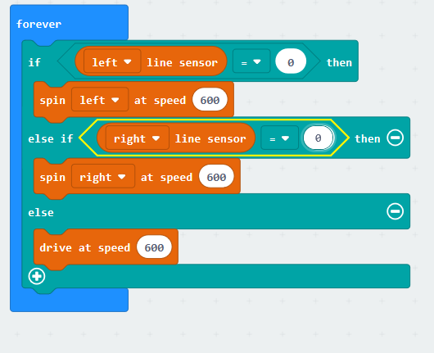
Practice Task
The code right (‘Lesson 16 linefollower.hex’) can be used to keep a Bit:Bot inside a square made up of black lines
It’s far from perfect but a good starting point
See how well this follows your test track and make refinements.
Think about
Do I want a line to follow around the track?
Do I want to use the line to stop me hitting an object?
Notes:
Explain that the code here is a starting point and may need some tweaking but to use it as a starting point
Get Learners thinking now about multiple cars on the track and how this could be a problem if we had multiple lines – start Learners thinking about how the lines could be used to help them avoid objects like barriers and corners

Slide 6
Success Criteria
Be able to apply what you have learnt to make the car complete one lap autonomously
Complete one safe lap as quickly as possible
Utilise sensors to automate the car and make the vehicle more ‘intelligent’

